Slide 1
Adidas product sales
By
Nagaraju illuri

Slide 2
Capstone power bi project:-Adidas product sales
Project Goals:-
In this project, I'm going to preprocess and clean data, run exploratory data analysis (EDA) and find descriptive statistical measurements as analysis data with making an interactive dashboard for a dataset which contains nearly 16000 product sales data.
Language, libraries, tools:
Language: Python
Libraries: Pandas, NumPy
IDE: Jupyter Notebook
Application: Microsoft Excel, Microsoft PowerBI

Slide 3
Data COLUMNS:-
Retailer :-Business entity selling goods or services.
Retailer ID :-Unique identifier assigned to a specific retailer.
Invoice Date :-Date when a transaction document is issued.
Region :-Geographical area for sales or distribution.
State :-Administrative division within a country.
City :-Urban center where retail activities occur.
Product:-Item available for purchase
Price per Unit :-Cost assigned to each individual item.
Units Sold :-Quantity of products sold in a transaction.
Total Sales :-Overall revenue generated from sales.
Operating Profit :-Net profit from business operations.
Operating Margin :-Percentage representing profitability relative to revenue.
Sales Method :-Approach or strategy used to make sales.

Slide 4
DATA SOURCES
PRIMARY DATA:-OUR CORE DATASET, EXTRACTED FROM KAGGLE’S “ADIDAS PRODUCT SALES” THIS DATASET INCLUDES PRODUCT,RETAILER INFORMATION,REGION,STATE,UNITS SOLD, PRICE PER UNIT,SALES METHOD ETC; IN THE COMPANY
SECONDARY DATA:- MARKET RESEARCH IMPORTS INDUSTRY ANALYSIS,AND CONSUMER BEHAVIOUR STUDIES PROVIDING SECONDARY DATA ON CUSTOMER DEMOGRAPHICS, PREFERENCES AND TRENDS.

Slide 5
methodology
Data Collection and Integration: Compile insights from Kaggle's "Adidas USA Sales Analysis" dataset, incorporating pivotal elements like region, product categories, and customer demographics to form a comprehensive foundation for in-depth analysis and understanding of Adidas sales trends in the USA
Creating an engaging Power BI dashboard for Adidas USA sales, the design focuses on visual appeal and user-friendliness. Interactive elements have been incorporated to facilitate exploration of customer preferences, enhancing the overall experience for analyzing sales trends and habits in the Adidas market.

Slide 6
tools and technologies
POWER BI FOR DASHBOARD
EXCEL FOR DATA EXTRACTION

Slide 7
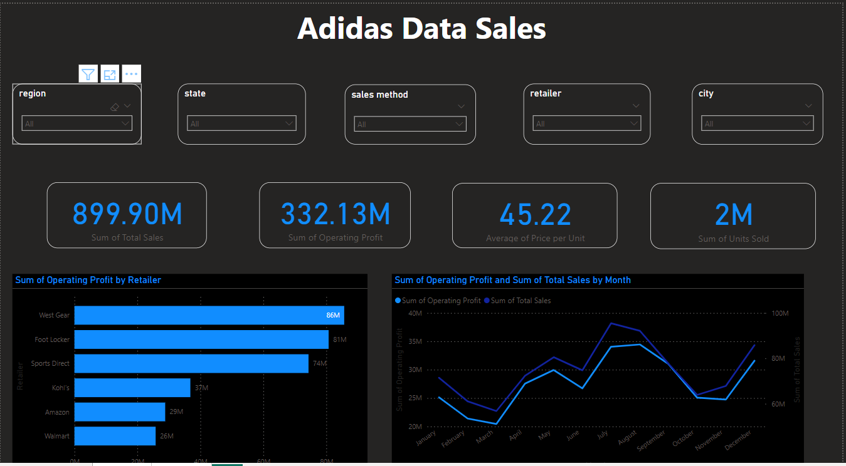
outcomes

Slide 8
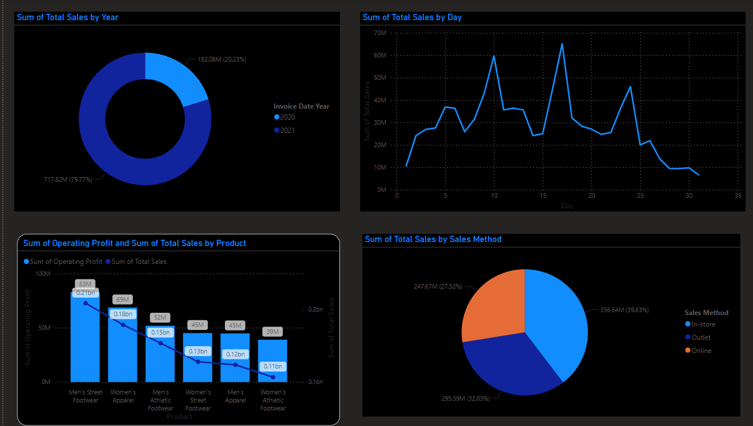

Slide 9
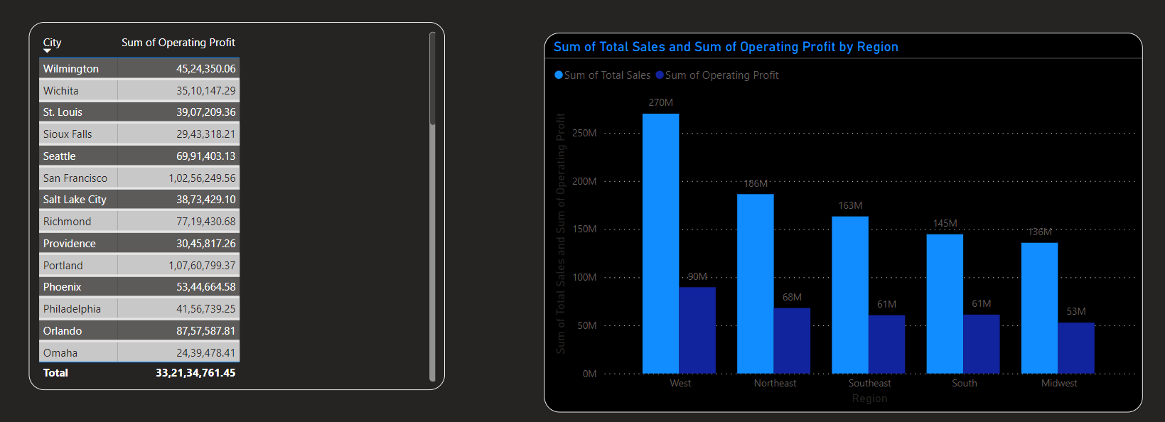

Slide 10
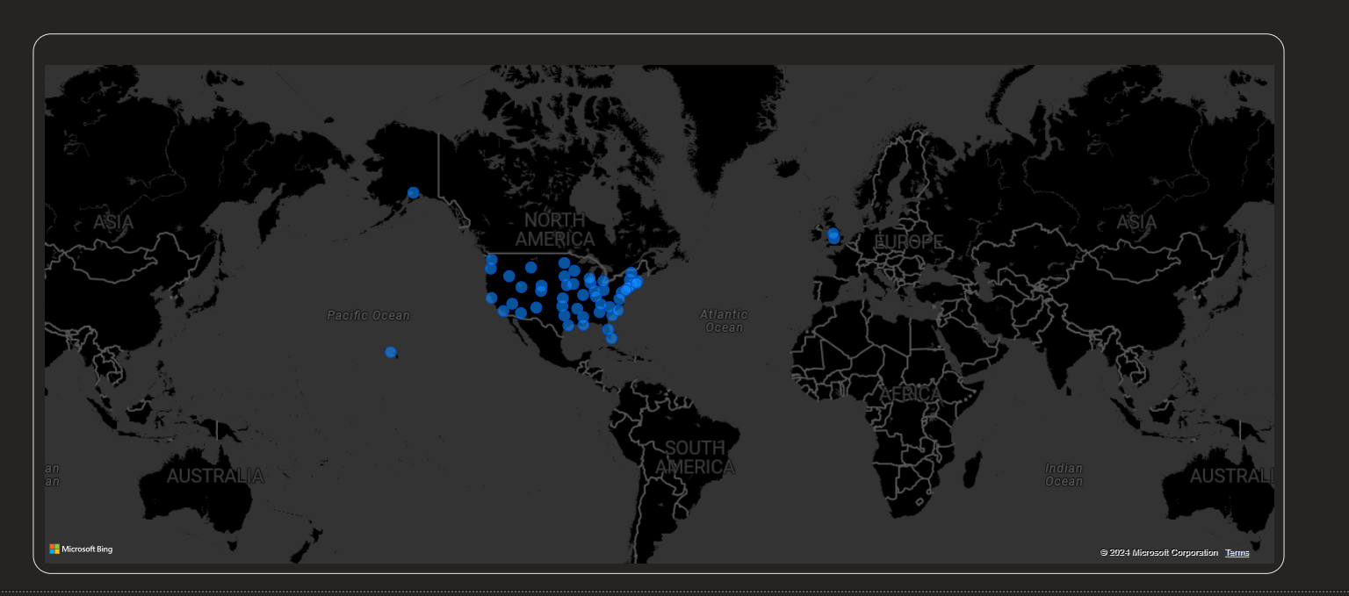

Slide 11
CONCLUSION
In conclusion, the Adidas USA Sales Power BI dashboard not only captivates with its visually appealing design but also provides a user-friendly platform for dynamic exploration of customer preferences. With interactive features seamlessly integrated, the dashboard becomes a valuable tool for gaining comprehensive insights into sales trends and consumer habits within the Adidas market, empowering strategic decision-making for the brand

